Slide 1
STUDENT DETAILS
Student Names : 1. Jay Gurav -53
2.Aditya Kale -58
3.Krushna Wankhade -59
College Name : D Y Patil College of Engineering & Technology , Kolhapur.
Project Domain : SuperStore Seals Data Analytics.

Slide 2
SUPER STORE DATA ANALYSIS
Problem Statement: The primary objective of this analysis is to identify the key factors impacting sales and profitability in the Superstore business. We aim to uncover patterns, trends, and opportunities for improvement to optimize business strategies and maximize profitability.

Slide 3
PROJECT OVERVIEW
Project Title: Super Store Data Analysis
Objectives:
Identify the top-performing product categories, regions, or customer segments
Analyze sales performance, profitability, and factors impacting business success
Uncover trends, patterns, and opportunities for improvement
Provide actionable insights to optimize business strategies and maximize profitability

Slide 4
Dataset Description:
The dataset used for this analysis is sourced from the Superstore database. It contains comprehensive information about sales transactions, including sales category states, city, Segments, Regions, Profit product categories, sales etc.. The dataset consists of 9977 rows and 13 columns.

Slide 5
SOLUTION AND ITS PROPOSITION
Solution: My analysis provides valuable insights into sales performance, profitability, and factors impacting business success. By leveraging data cleaning, exploratory data analysis, and visualization techniques.
Value Proposition:
Optimize Profitability
Enhanced Sales Performance
Improves Customer Satisfaction
Data Analysis Reference
Competitive Advantages

Slide 6
CUSTOMIZATION &UNIQUENESS
How did you customize the project and make it your own:
Selected relevant dataset (Sample Superstore)
Applied data cleaning and exploration techniques
Customized visualizations for clarity and aesthetics
Generated valuable insights and actionable recommendations
segments to focus on and improve targeting and sales strategies.

Slide 7
Statistical Analysis:
Descriptive Analysis : Utilized descriptive statistical techniques, such as calculating mean, median, and standard deviation, to summarize and explore key variables.
Generated descriptive statistics to understand the central tendency, variability, and distribution of the data.
Visualization:
Utilized various visualization techniques, including bar plots, pie charts, line plots, and scatter plots, to effectively communicate the findings of the analysis.
Created visually appealing and informative graphs and charts to present the insights to stakeholders.

Slide 8
RESULTS AND OUTPUTS

Slide 9
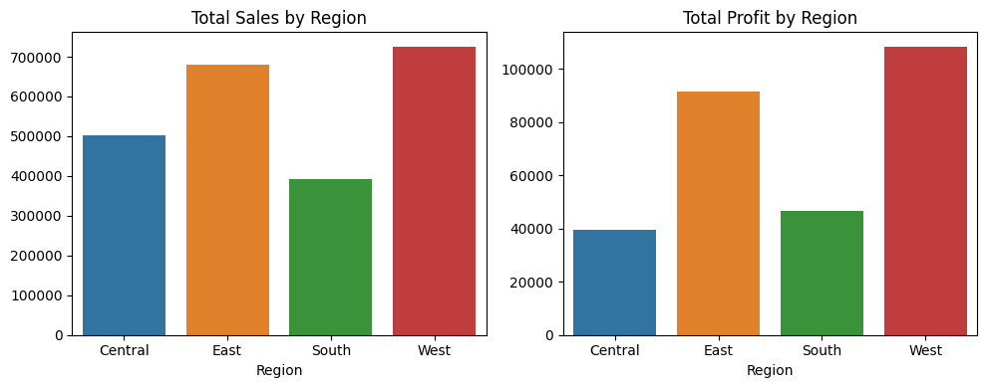
Profit Analysis
Analyzed the sales and profit distribution by region. The left chart displays the total sales by region, highlighting regions with high sales volume. The right chart shows the total profit by region, identifying regions with strong profit margins. These insights inform strategic decision-making, resource allocation, and revenue optimization.

Slide 10
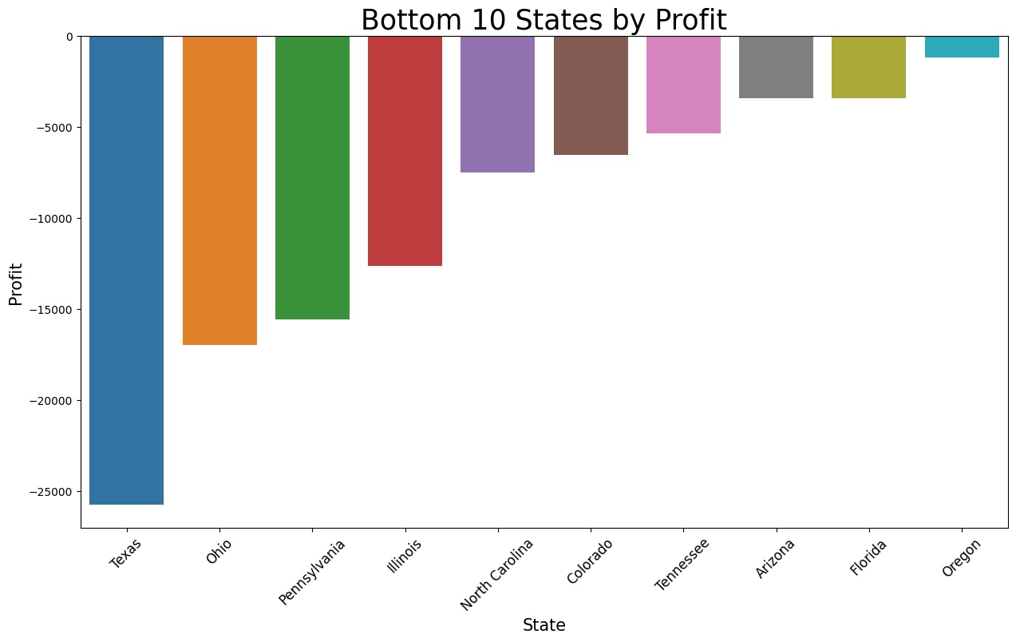
I have analyzed the profitability of different states and identified the bottom 10 states based on profit generated.
The analysis of the bottom 10 states by profit provides valuable insights into areas where the company can focus on improving profitability

Slide 11
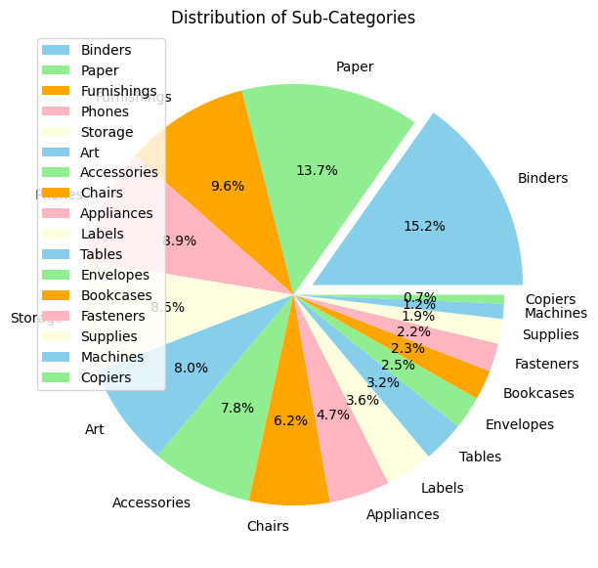
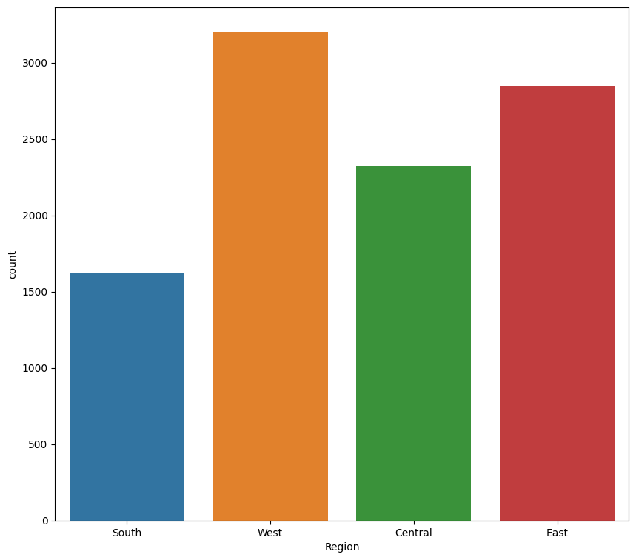
Distribution Analysis
Figure: Distribution of Sub-Categories
Figure: Distribution of Sales by Region

Slide 12
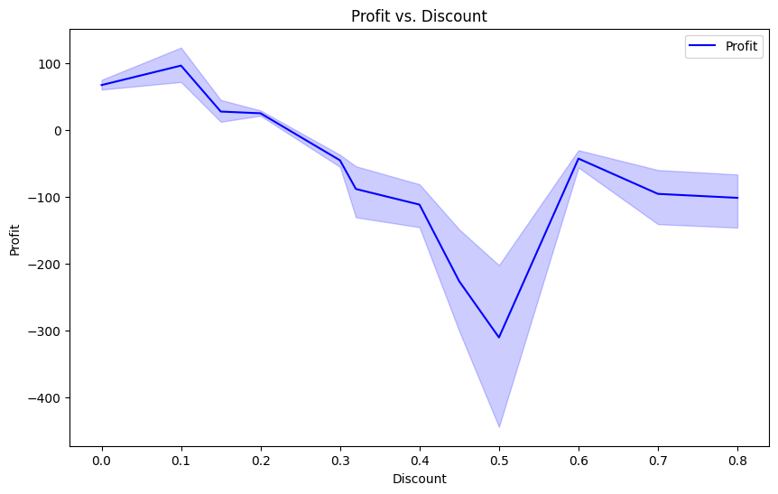
Additional Visualizations
Figure: Profit and Purchasing Patterns by Segment
Figure: Profit vs. Discount

Slide 13
CONCLUSIONS
The analysis reveals that the Home Office segment contributes significantly to the overall profit.
Profit is high in South & less in central part
Highest profit is earned in copiers while selling price for chairs & phones is extremely high compared to other products
Technology category is more number in count
In region wise more count is in west region and many more conclusions can be made.

Slide 14
LINKS
https://github.com/Varshithays/Superstore_dataAnalysis/tree/main
https://www.kaggle.com/
https://www.python.org/
https://skillsbuild.org/
https://jupyter.org/try
https://www.ibm.com/products/watson-studio

Slide 15
THANK YOU

